Slide 1
Foothills Parkway Micropiles Support Closing the Missing Link
by
Anthony Sak, P.E.
STGEC 2016
Biloxi, Mississippi
November 9, 2016

Slide 2
Presentation Outline
Introduction
Parkway History
Project Overview
Site and Subsurface Conditions
Micropiles
Project Foundation Construction

Slide 3
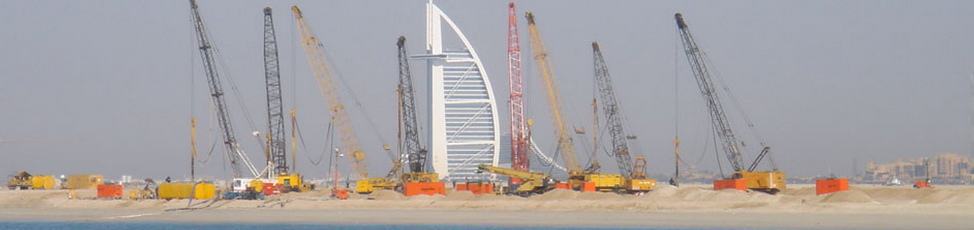
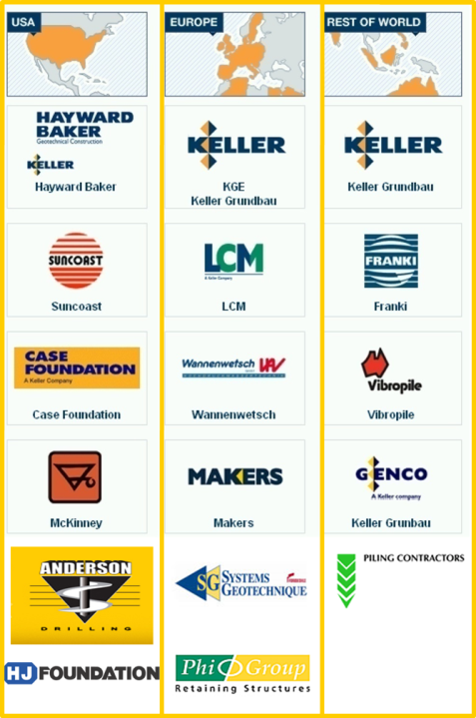
But first, just a little about us…
Hayward Baker Inc. (HBI) is North America’s leading specialty geotechnical contractor, offering the full range of pre and post-construction services.
Foundation rehabilitation, settlement control, soil stabilization, excavation support, etc.
US headquarters are in Hanover, MD (Baltimore area)
Annually ranked #1 in our field by Engineering News Record
Keller Group plc is Hayward Baker’s parent company headquartered in London.
Publically owned and traded on the UK stock market
Offices in over 40 countries on 6 continents

Slide 4
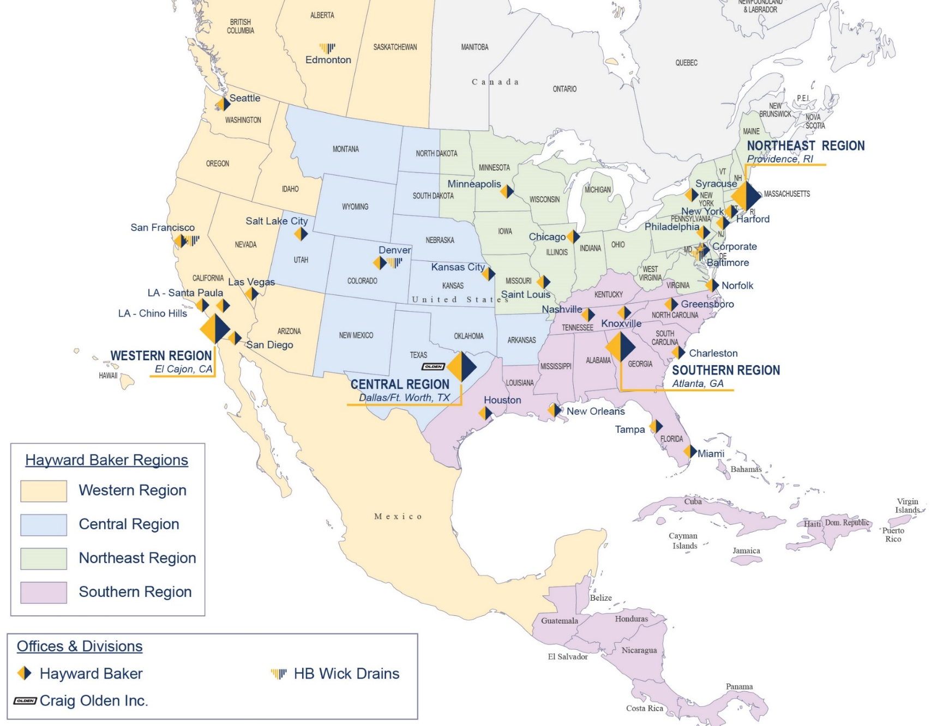
Hayward Baker’s National Presence

Slide 5
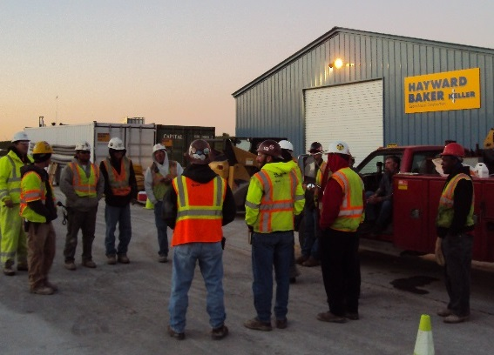
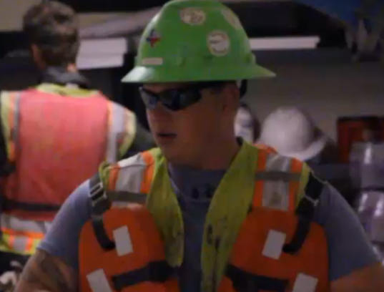

Goal: Zero Injuries
THINK SAFE
WORK SAFE
GO HOME SAFE

Slide 6

Geotechnical Problem… Hayward Baker Solution

Slide 7
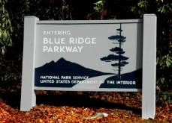
Parkways in the Southeast
Smoky Mountain National Park (NC side) to Shenandoah National Park (Virginia) – 469 miles
Construction from 1935 to 1987

Slide 8
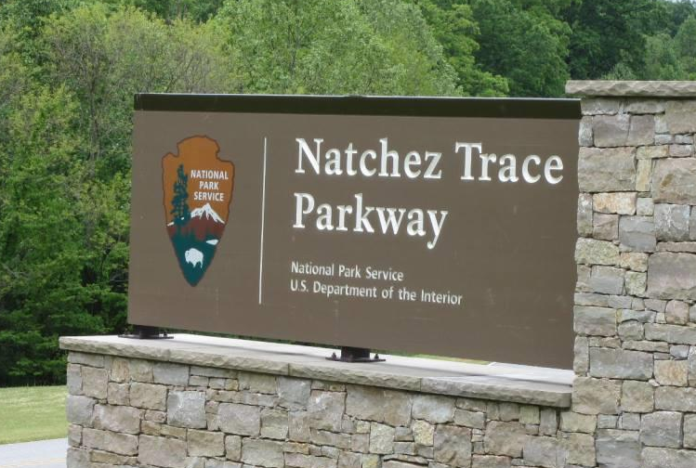
Parkways in the Southeast
Natchez, MS to Nashville, TN – 444 miles
Construction from 1938 to 2005

Slide 9
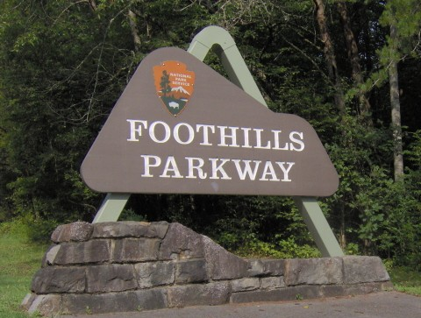
Parkways in the Southeast
North side of Smoky Mountain National Park (TN side) – 72 miles
Construction from 1960 to ?

Slide 10
Foothills Parkway History
Congress authorized – February 22, 1944
Provide beautiful vistas of Smoky Mountain NP
Disperse visitor traffic
Two lane, 72 miles in 8 segments (A-H)
Initial construction began in 1960’s; sections A and G to H open
Construction of Segments E and F (16.1 miles) begin in 1984 and 1985
Segment E contract terminated in 1989
MSE retaining wall failures
E&S problems leading to acid runoff from pyritic rock
The 1.65 mile “Missing Link” is born

Slide 11
Foothills Parkway History
1990’s Missing Link redesigned by FHWA:
Minimize surface disturbance and environmental impacts
Mitigate previous erosion and wall problems
Series of 10 bridges (1 through 10)
Bridges 1, 2, 8 – 10 completed 2001 through 2012
Bridges 3 to 7 under construction
Design-build delivery - $46.2 million contract
Contractor - Lane Construction
Designer - HDR
Future final paving, safety, and signage of Segments E and F (est. $30M)
Sometime in the future… the final 30 miles

Slide 12
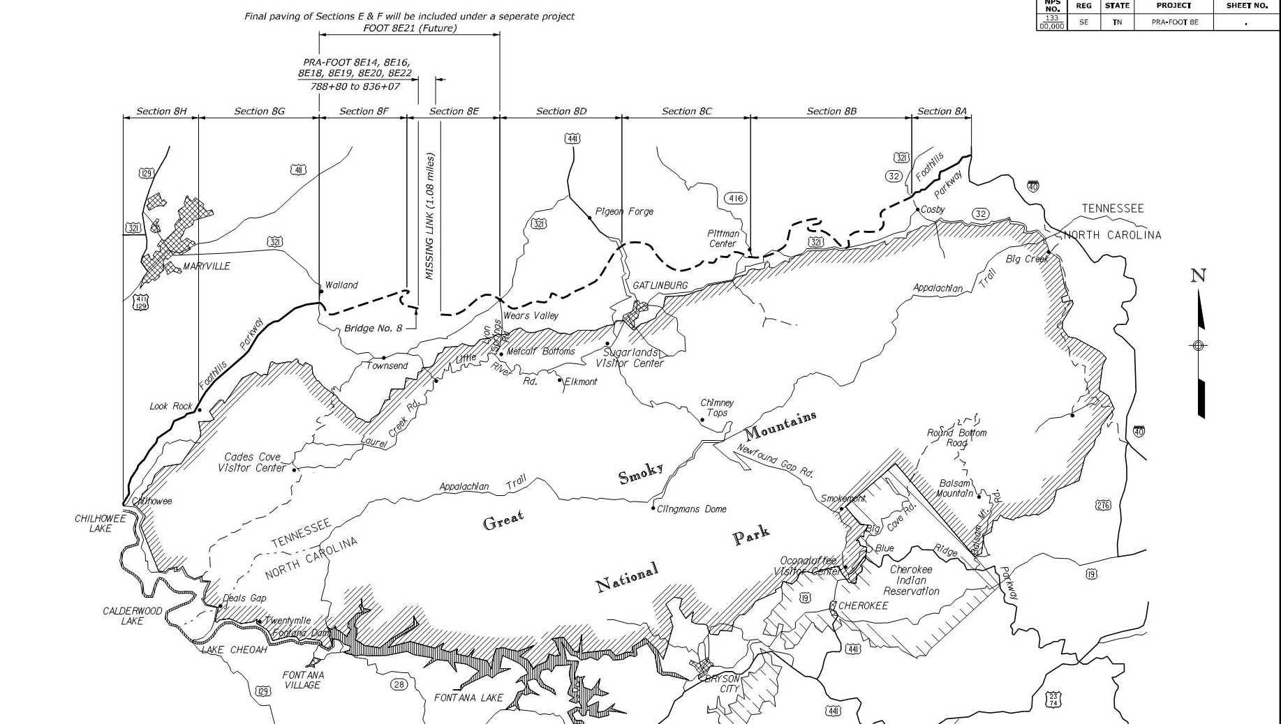
Where is the Missing Link?
5.6 miles
16.1 miles
16.9 miles
Missing Link
Notes:
Insert your content/slides.

Slide 13
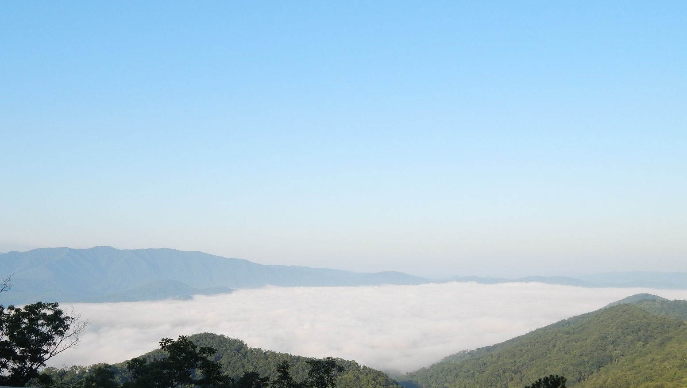

Slide 14
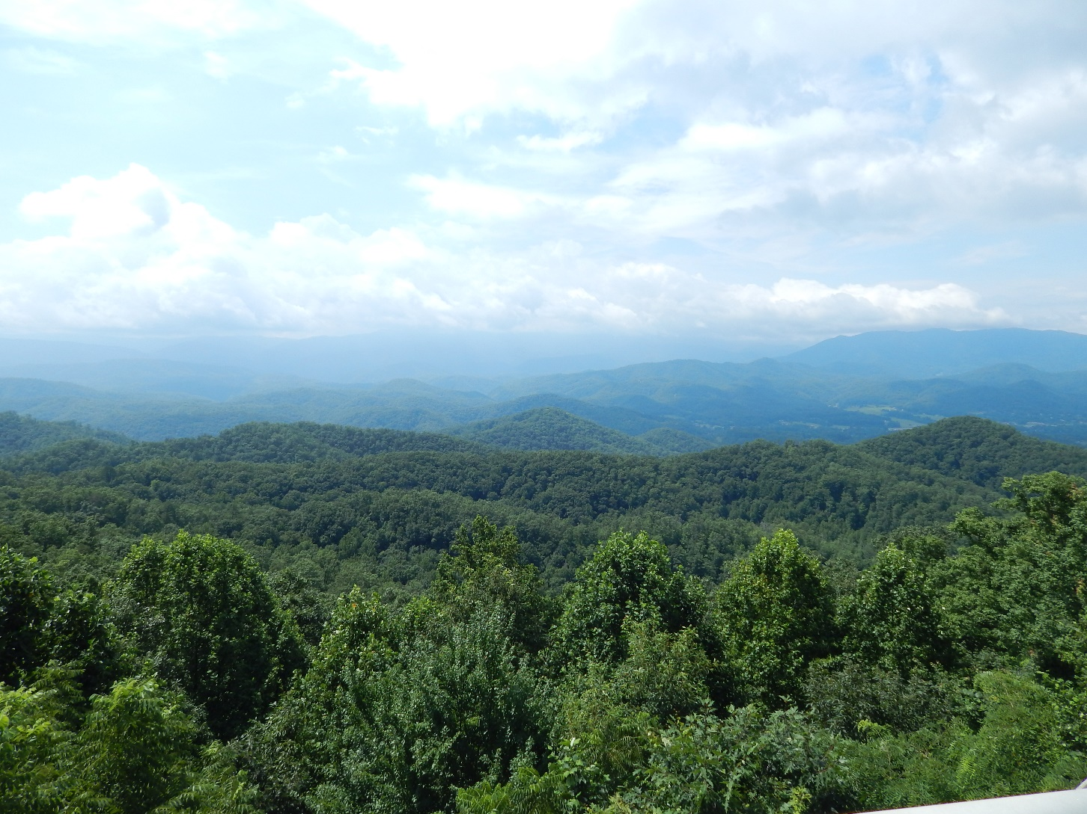

Slide 15
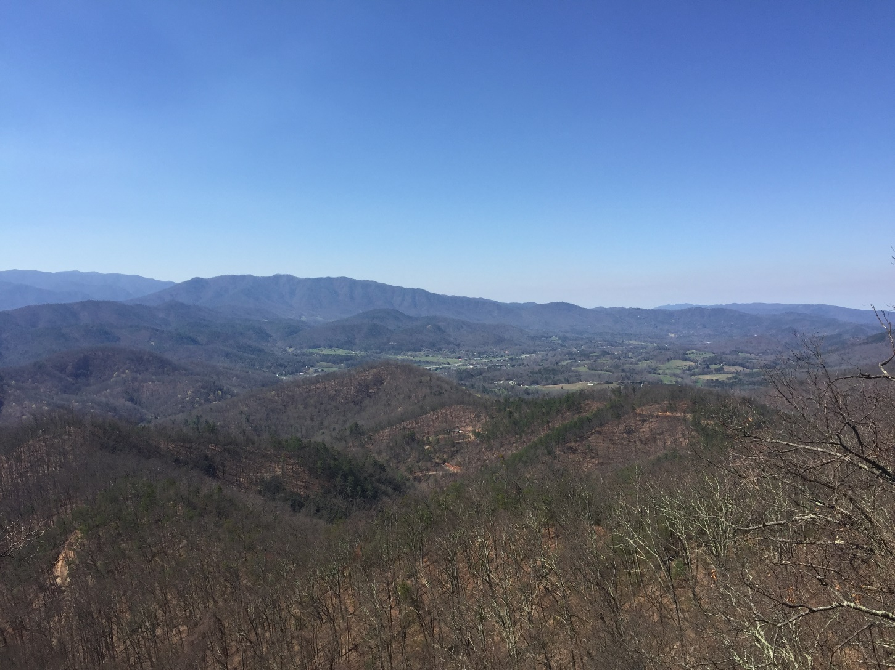

Slide 16
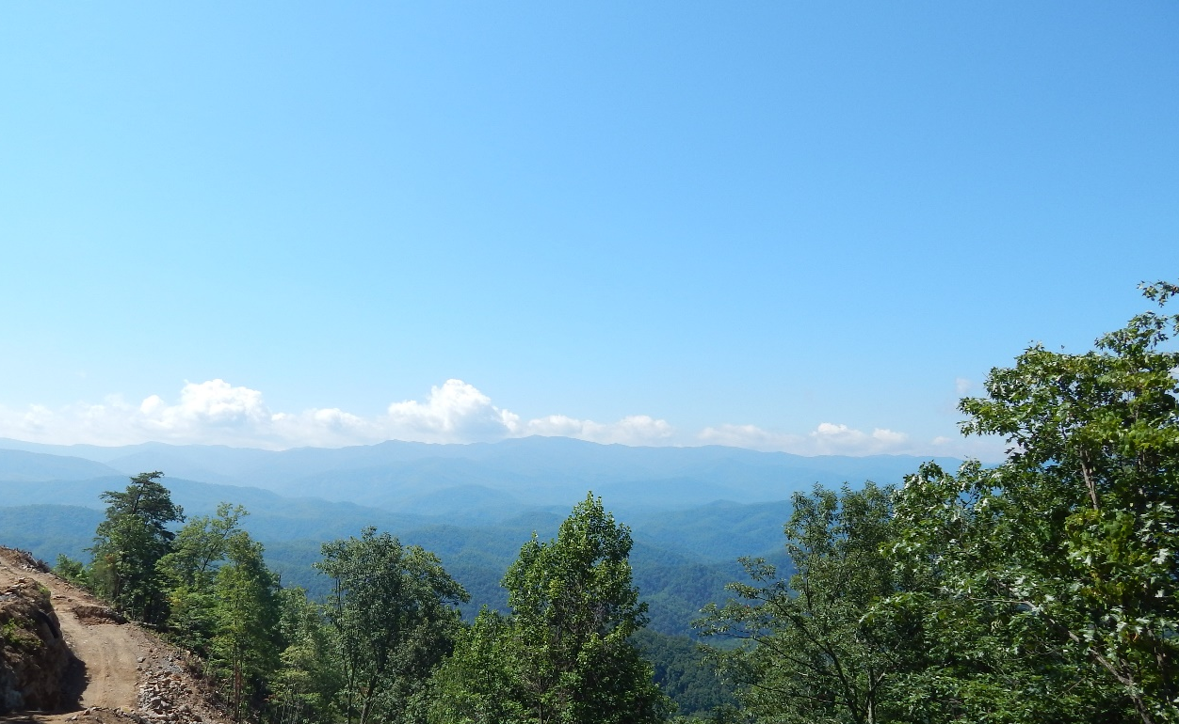

Slide 17

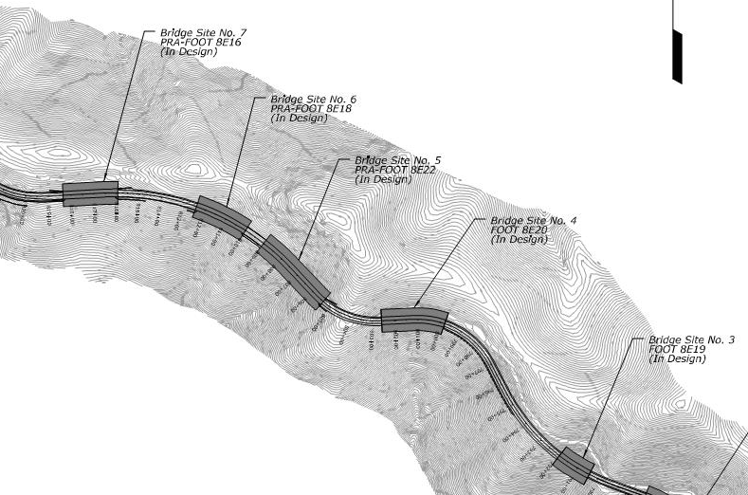
Missing Link Bridges
Notes:
Insert your content/slides.

Slide 18
Bridge Design
Bridge 3 - Single span, 158.5 feet
Both abutments founded on micropiles (MPs)
Bridge 4 - Two span, 290 feet
Abutment 1 and Pier 1 founded on MPs
Abutment 2 founded on spread footings
Pier 1 – permanent rock dowel SOE
Bridge 5 – Two span, 336.5 feet
Founded on spread footings
Bridge 6 – Single span, 215 feet
Both abutments founded on spread footings
Bridge 7 – Single span, 215 feet
Both abutments founded on MPs

Slide 19
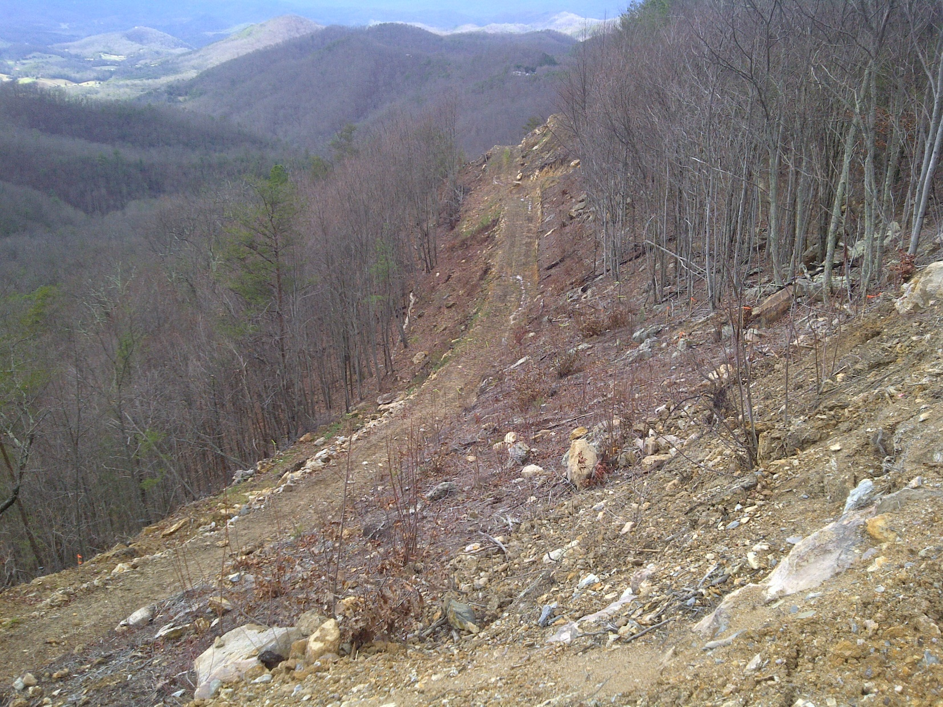
Pre-Construction Site Conditions

Slide 20
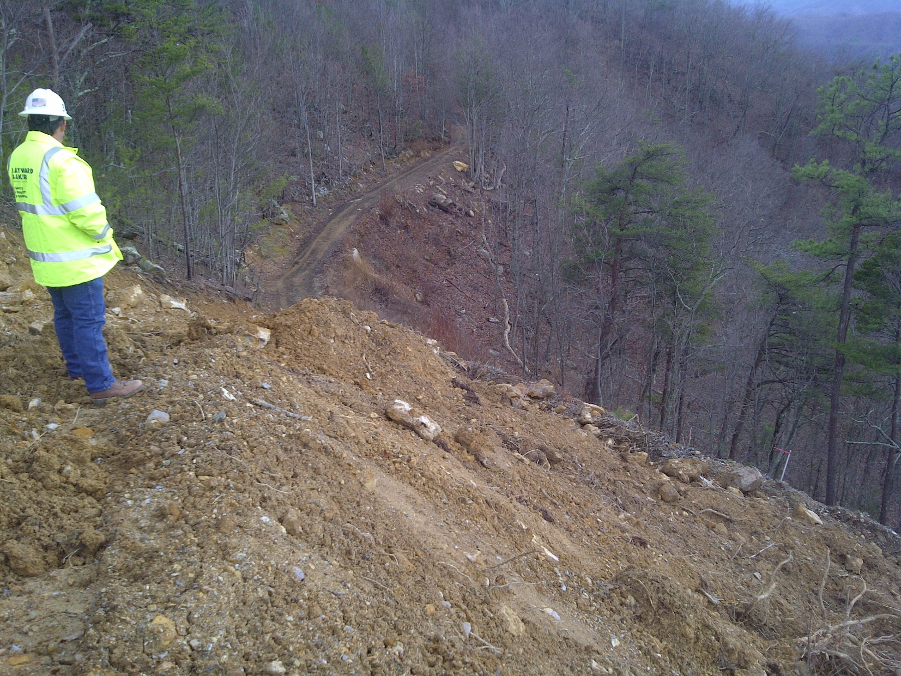

Slide 21
Subsurface Conditions
Meta-sandstone, meta-conglomerate, and occasional phyllite
Residual soil – 0 to 15 ft thick
Highly weathered rock (50 blows < 6 in) – 0 to 10 ft thick
Fractured rock
Competent rock – depth varies 20 to 45 feet
REC > 85%
RQD > 50%

Slide 22
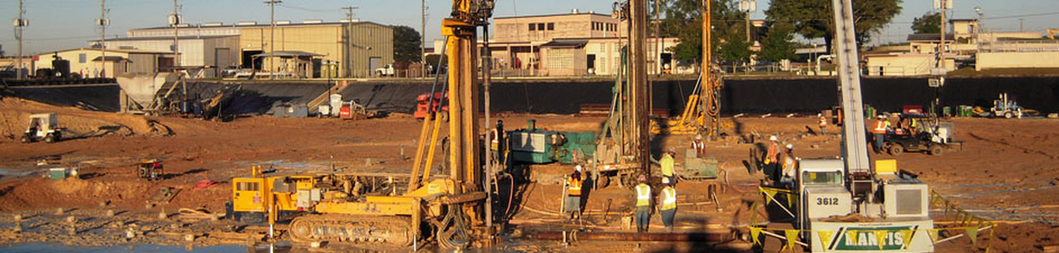
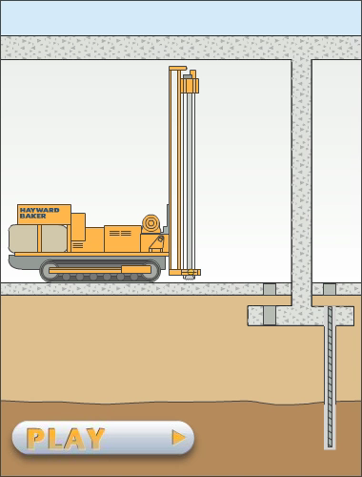
Micropiles: Overview
Structural Load Bearing Elements
Usually drilled-in
Installed vertical or battered
Capacities as little as 3 tons to more than 500 tons
Depths of 200+ feet
Also known as minipiles, root piles, pipe piles, etc.
Micropiles

Slide 23
Micropiles are routinely used for:
New Construction
Underpinning existing Foundations
Limited access or low headroom
Foundations where obstructed drilling is required
Deep foundations in Karst Geology
Replacements for failed existing deep foundations
Seismic Retrofit
Slope Stabilization

Slide 24
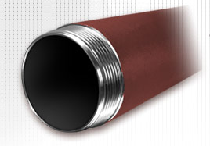
Micropile Materials
Permanent Steel Pipe
API N80 & ASTM A252
80 ksi yield
Flush joint threads
Steel Reinforcement
ASTM A615, Gr. 60 & 75 80, 95 & 100
ASTM A722, Gr. 150
Mechanical coupling
Cement Grout
Neat cement – ASTM C150
W/C ratio of 0.45
4,000 psi (min)

Slide 25
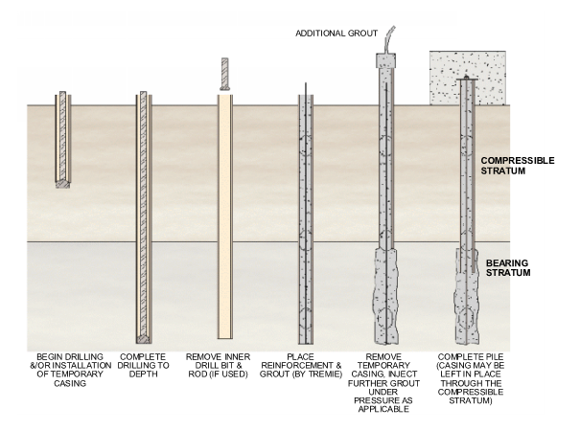
MP Installation

Slide 26
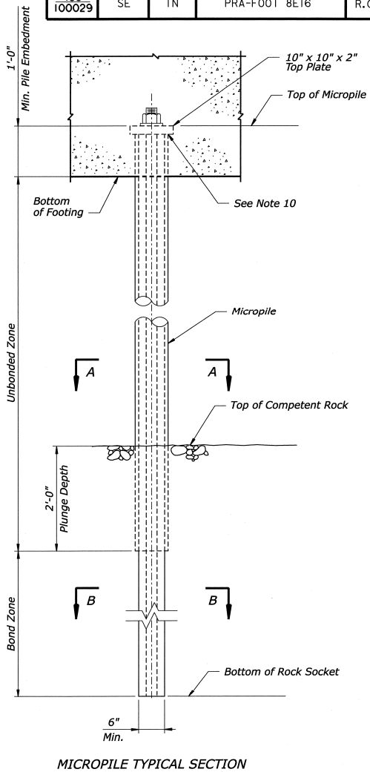
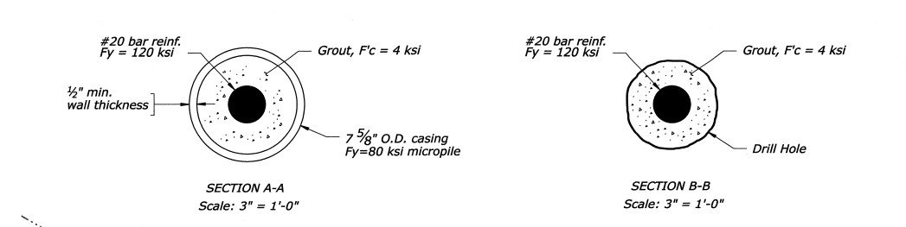
Micropile As-Designed

Slide 27
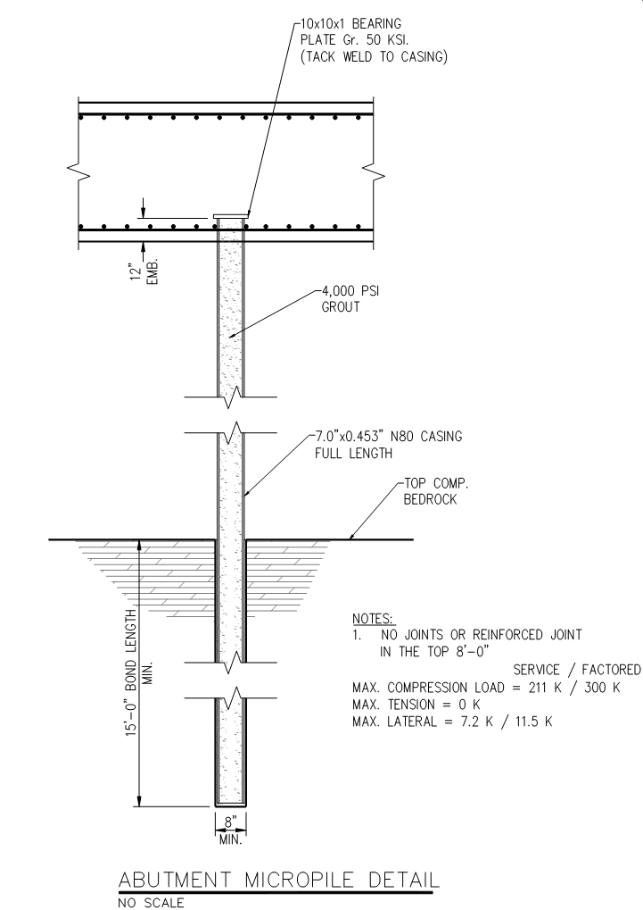
As-Designed
Value- Engineered
vs.

Slide 28
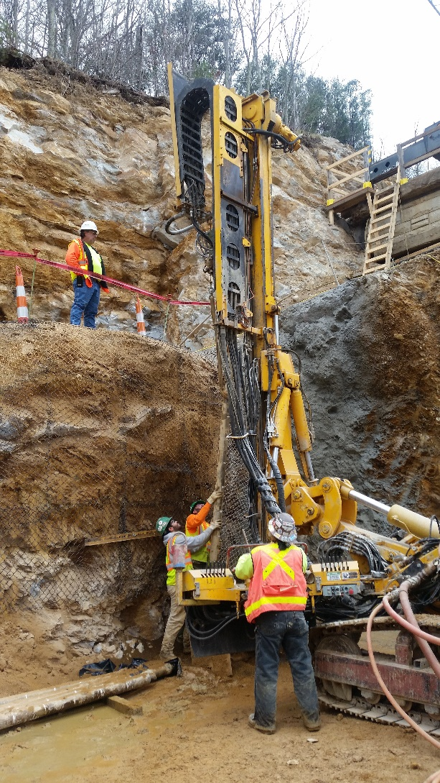

Slide 29
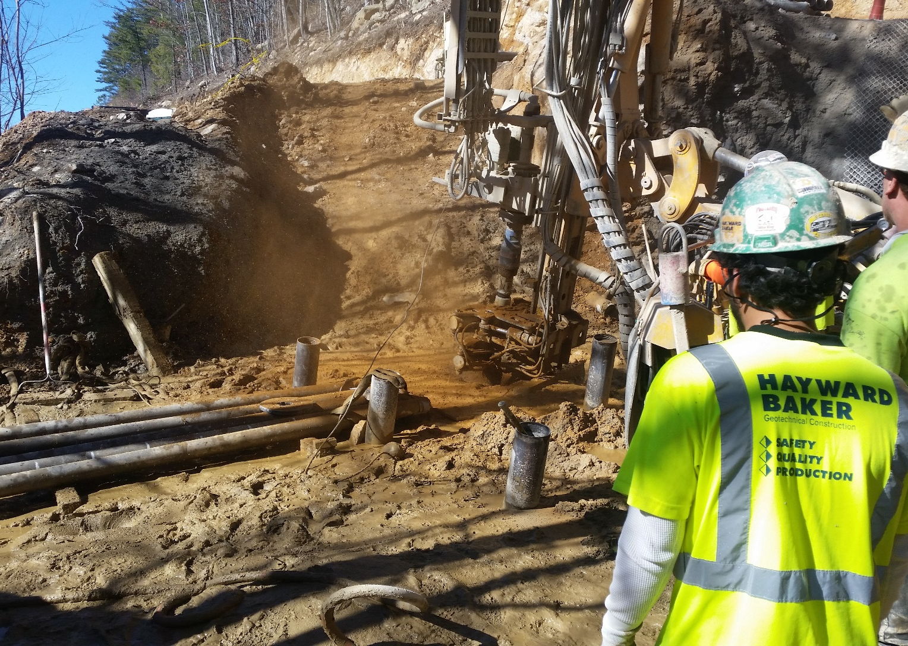

Slide 30
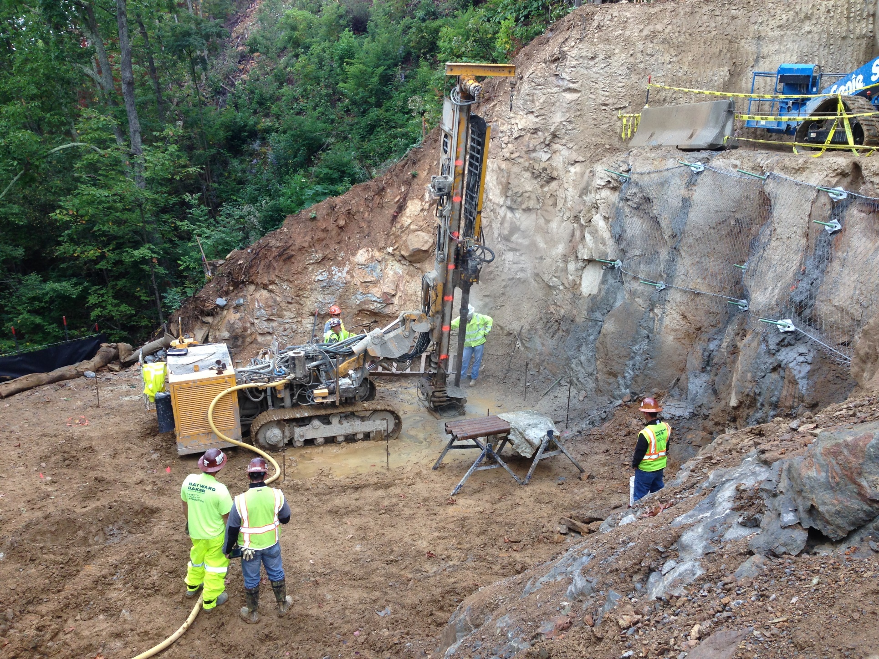

Slide 31
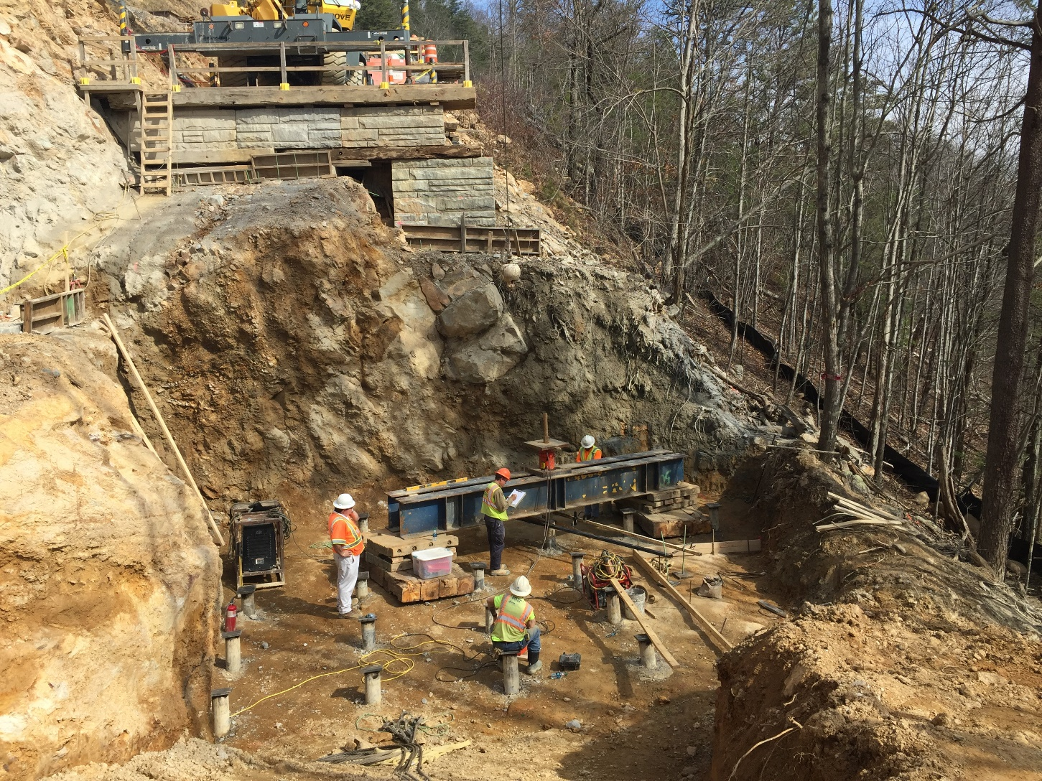

Slide 32
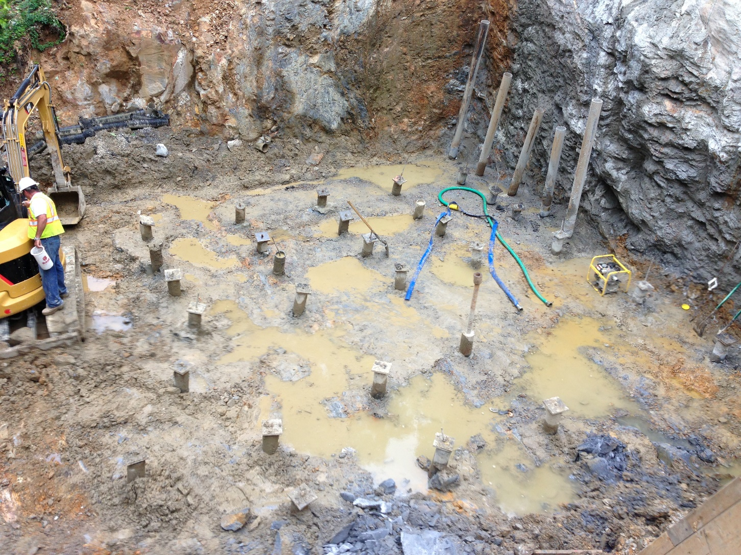

Slide 33
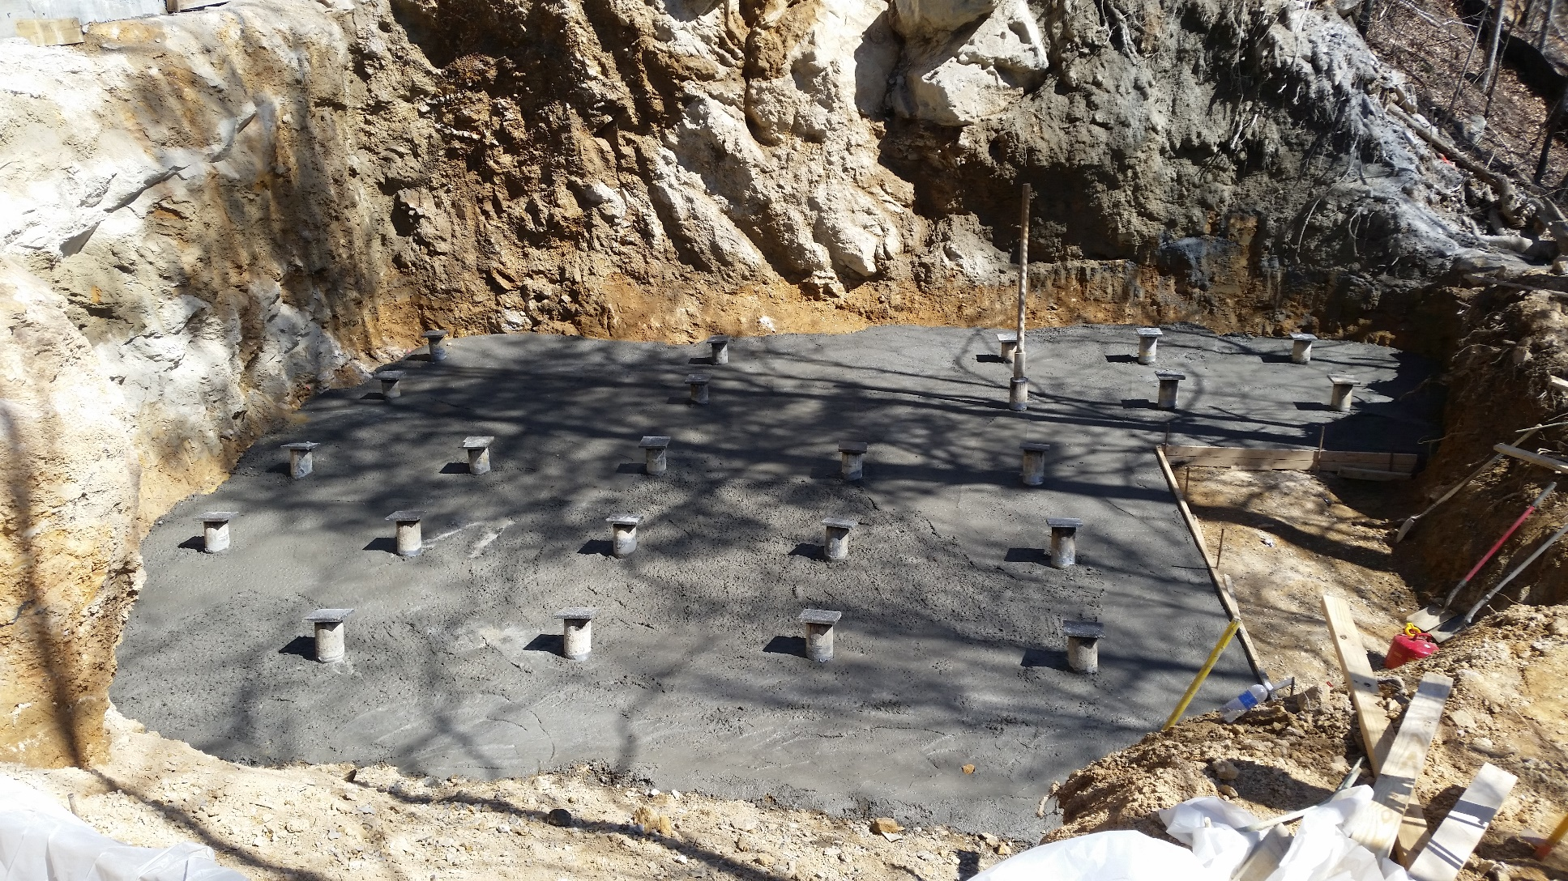

Slide 34
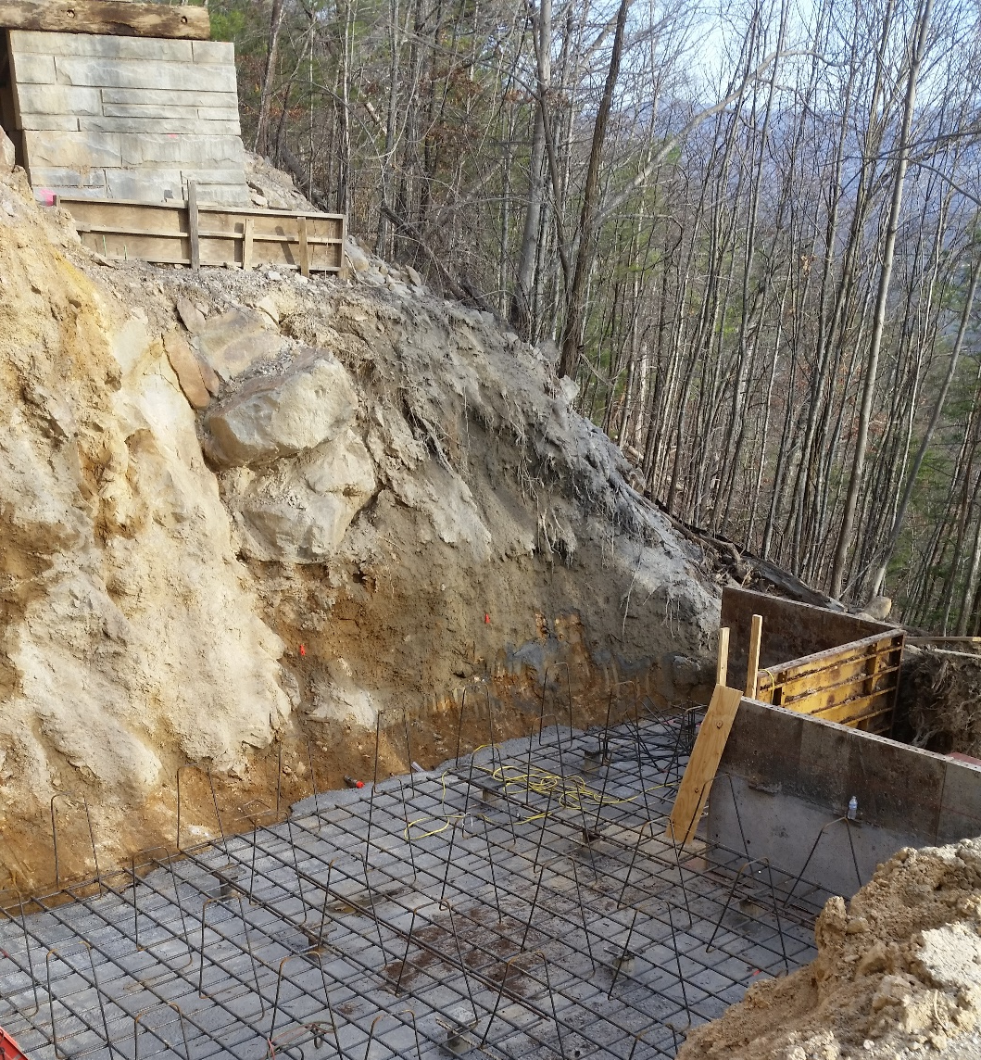

Slide 35
MP Testing
Verification compression load test
Sacrificial MPs
2 x the design (unfactored) load ~ 430 kips
Tension proof load test
Production MPs
1.6 x design (unfactored) load ~ 344 kips

Slide 36
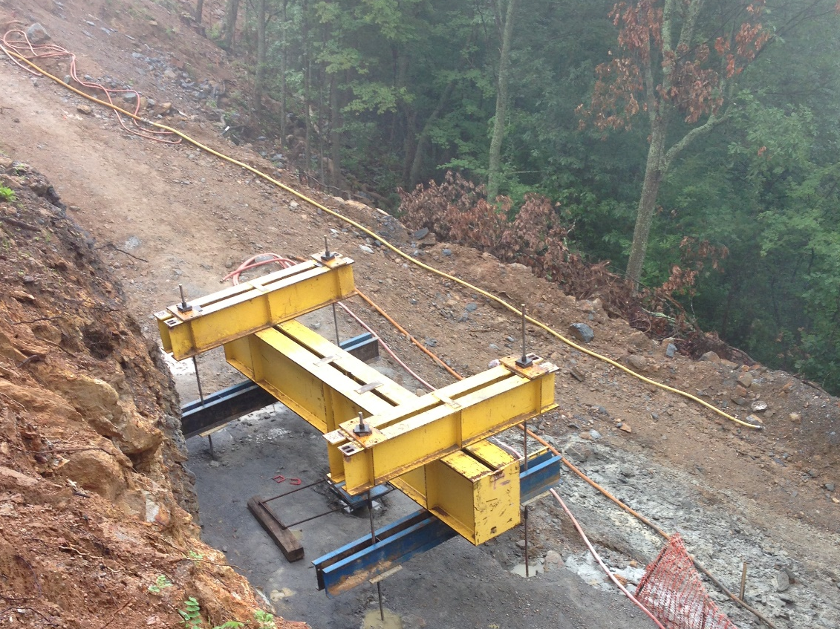

Slide 37
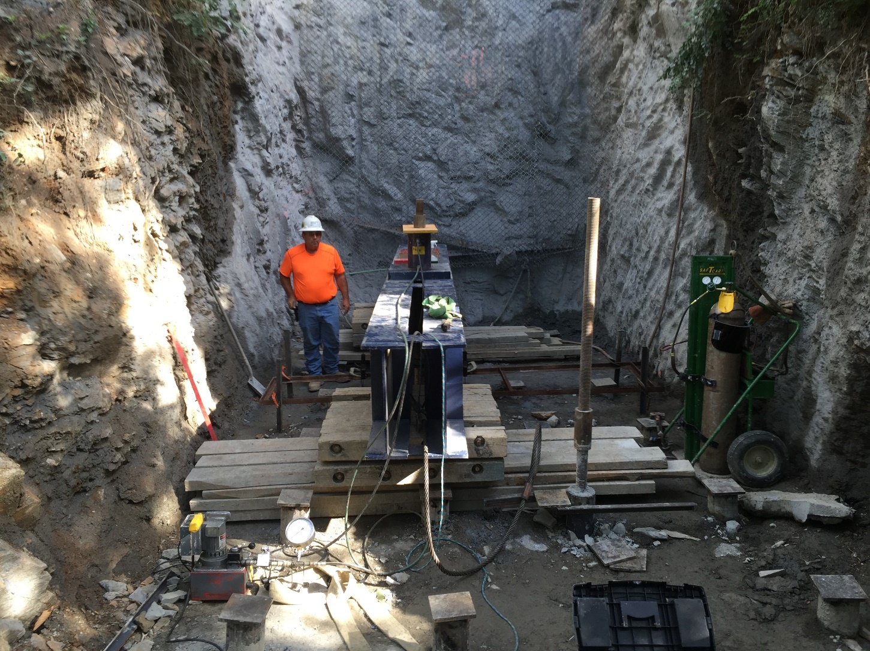

Slide 38
How were the Bridges Constructed?
Cast-in-place, post-tensioned box girders

Slide 39
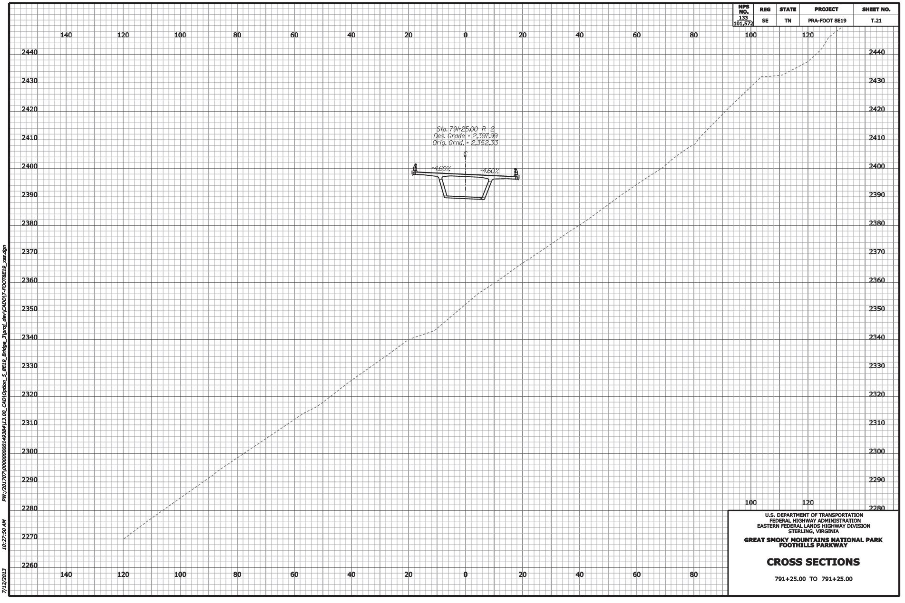

Slide 40
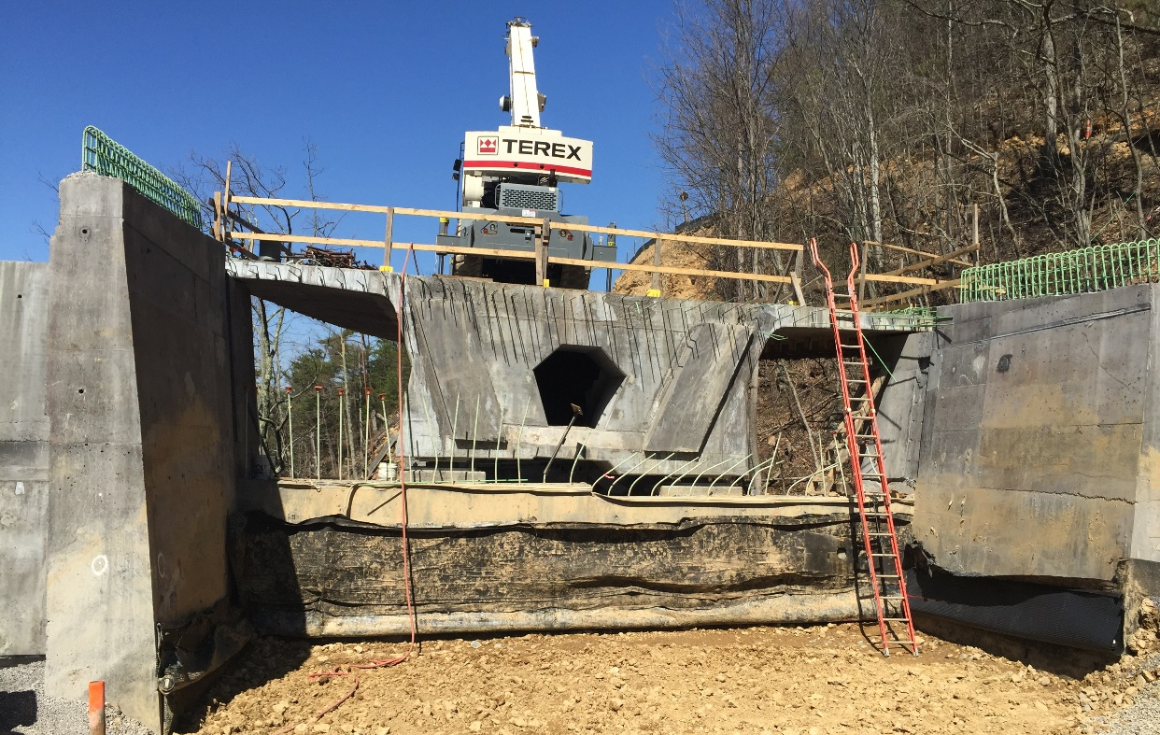
How were the Bridges Constructed?
Cast-in-place, post-tensioned box girders
Since CIP, need temporary falsework
Falsework needs foundations

Slide 41
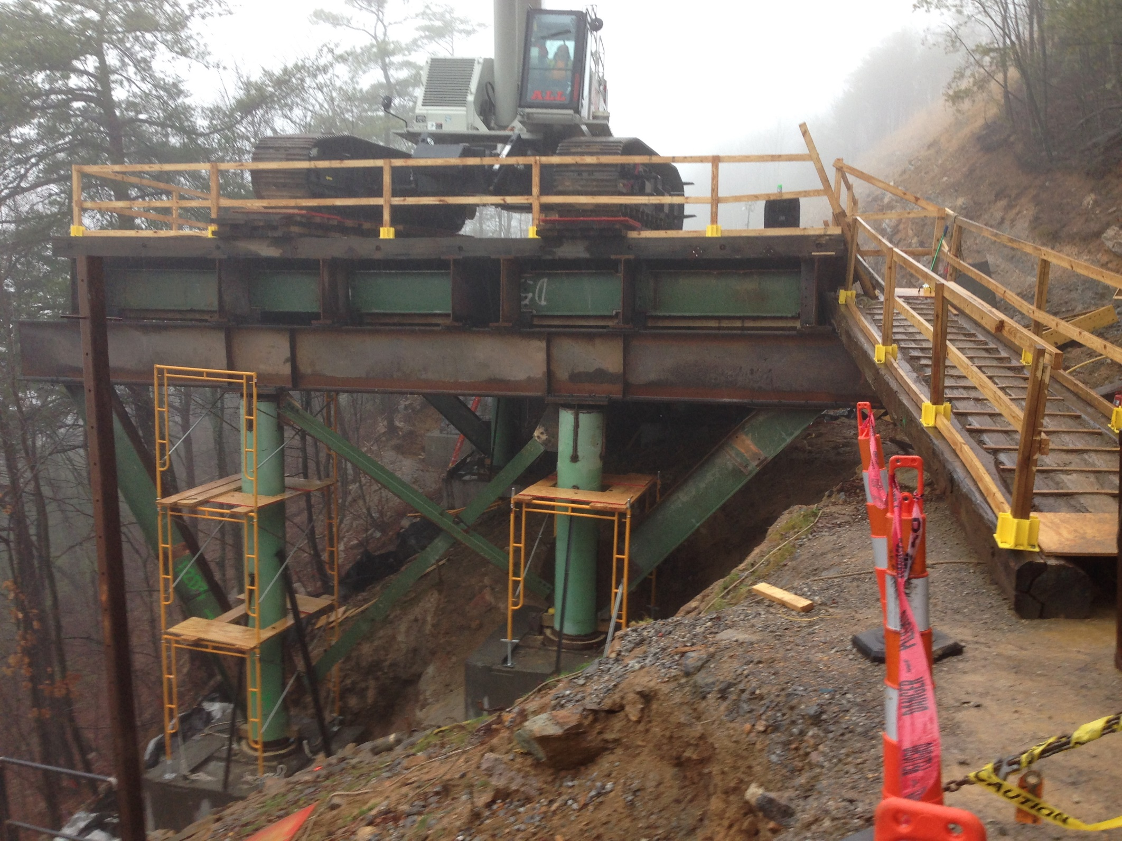

Slide 42
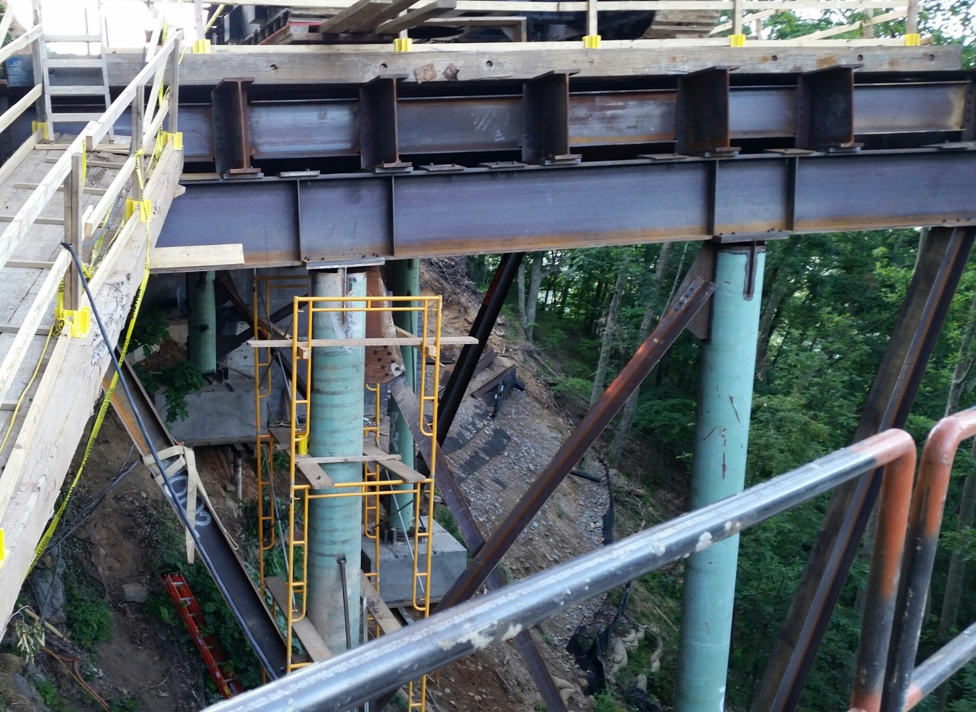

Slide 43
How were the Bridges Constructed?
Cast-in-place, post-tensioned box girders
Since CIP, need temporary falsework
Falsework needs foundations

Slide 44
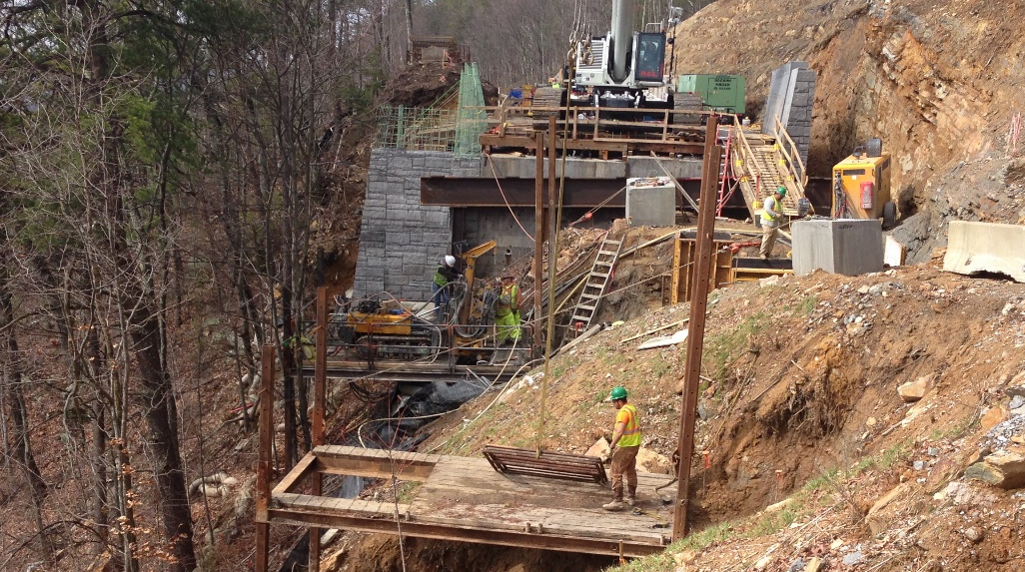
Falsework Foundations
GC set work platforms at each location

Slide 45
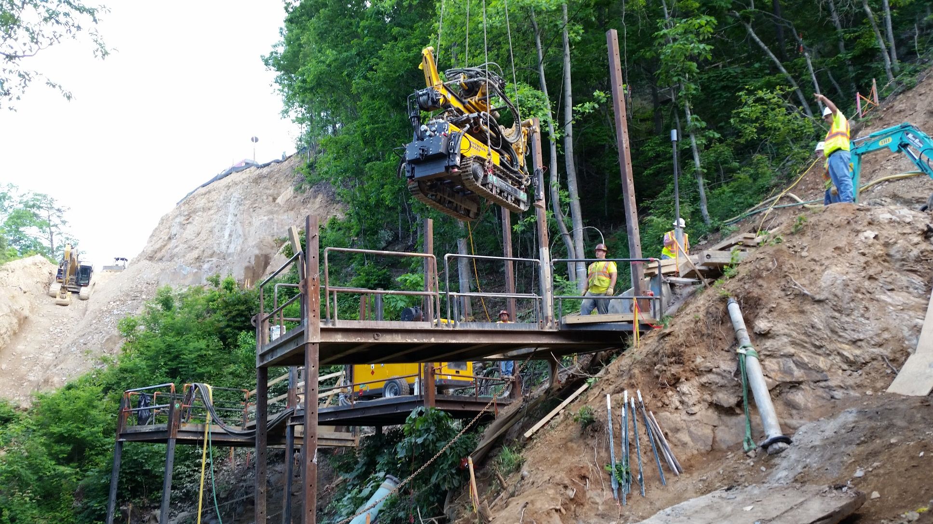
Set Small Drill Rig on Platform

Slide 46
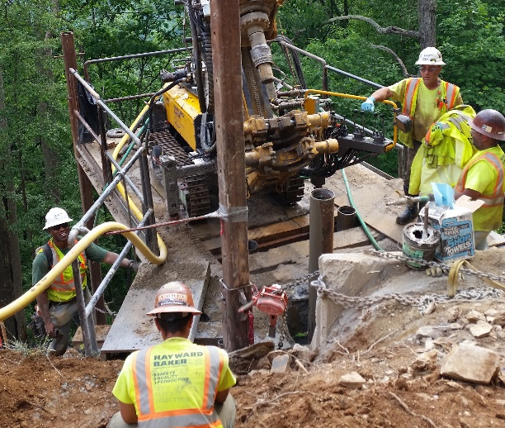

Slide 47
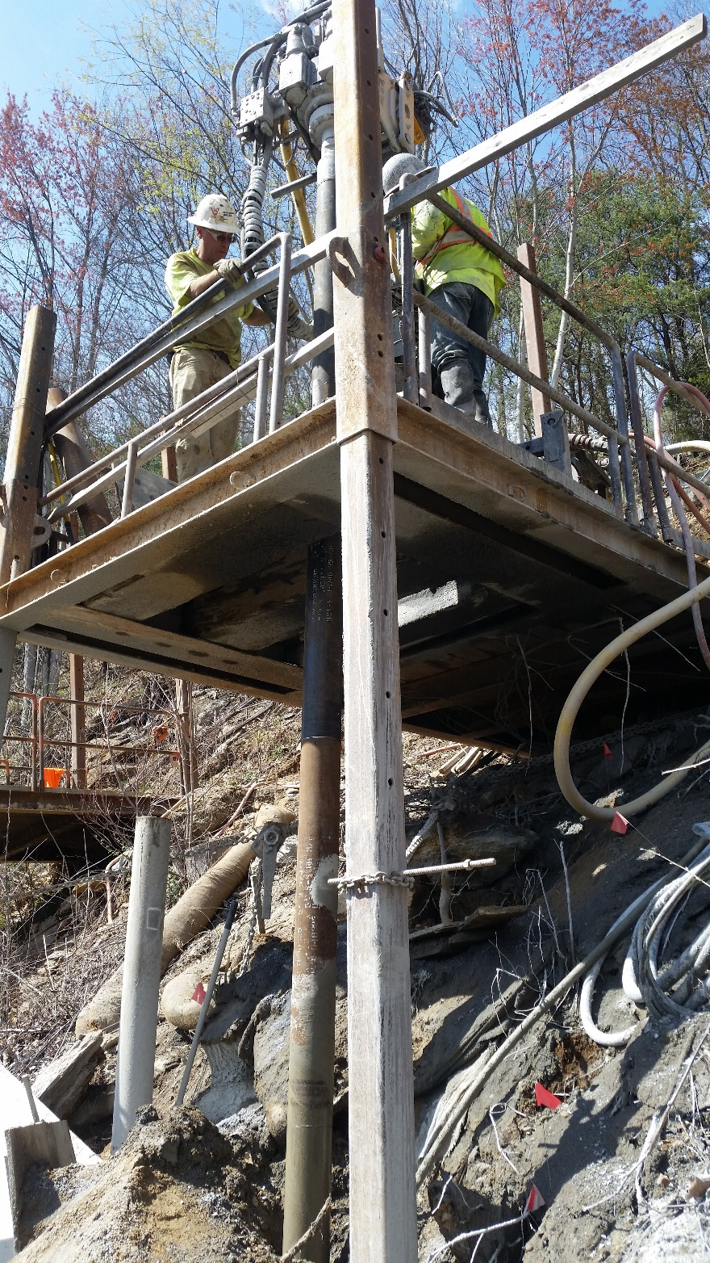
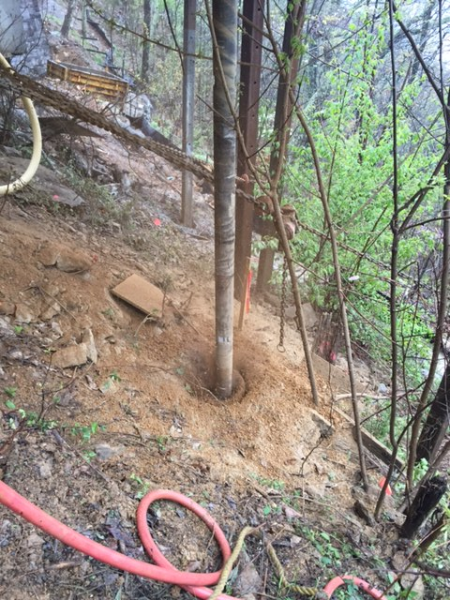

Slide 48
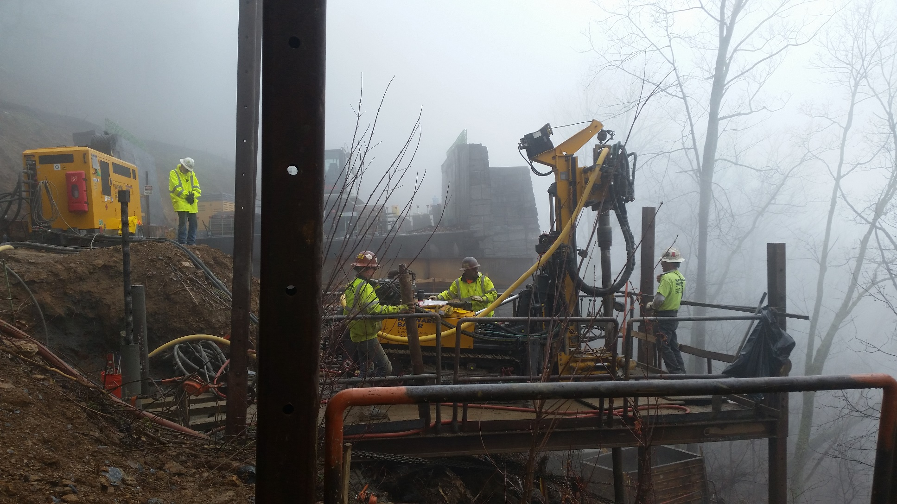

Slide 49
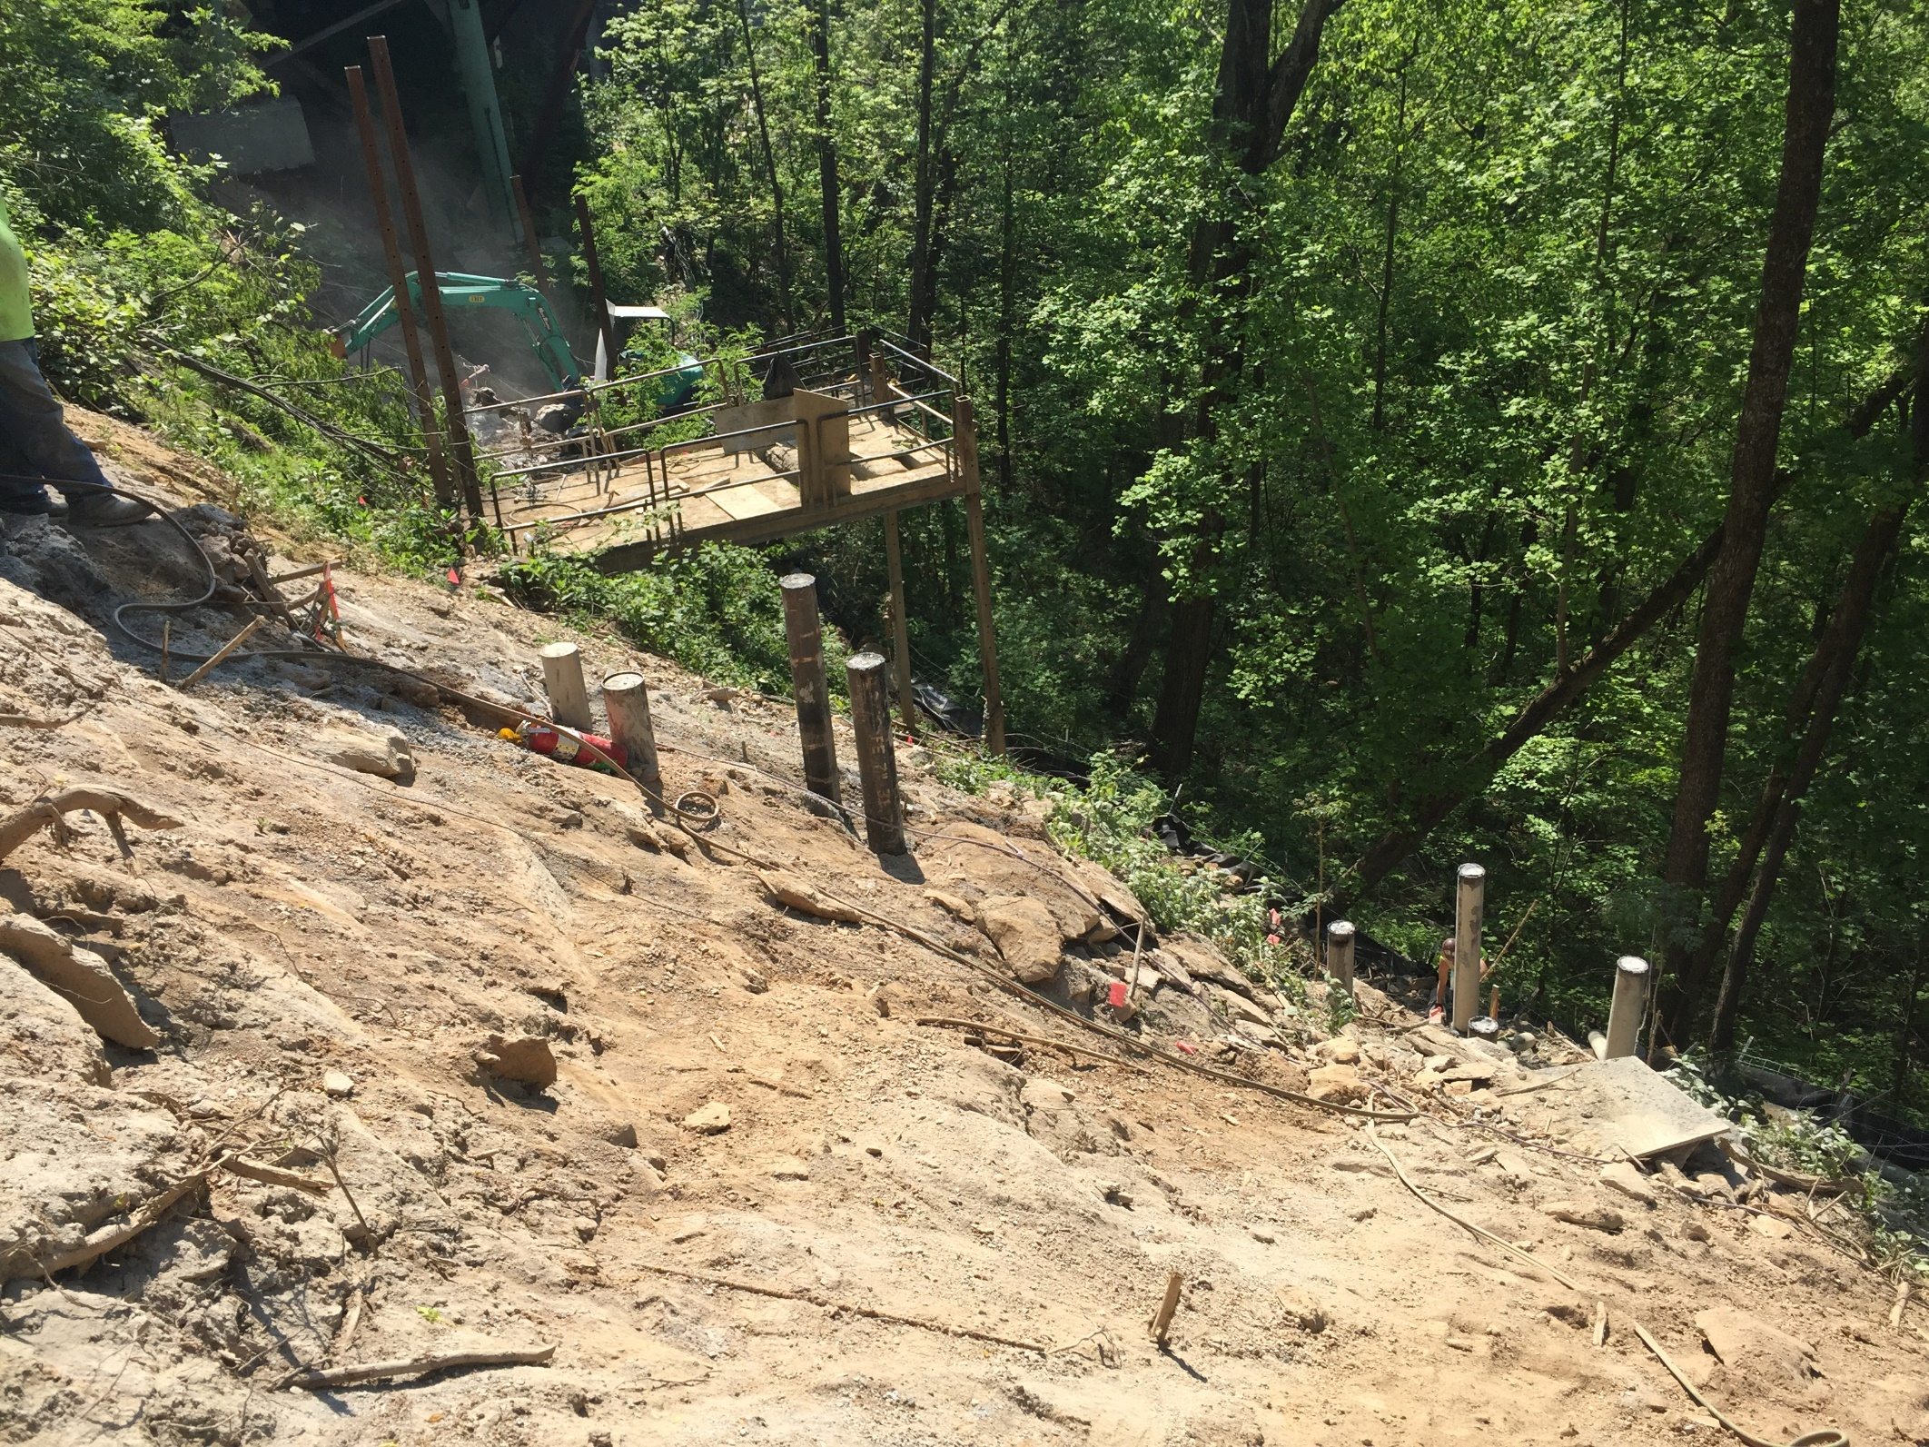

Slide 50
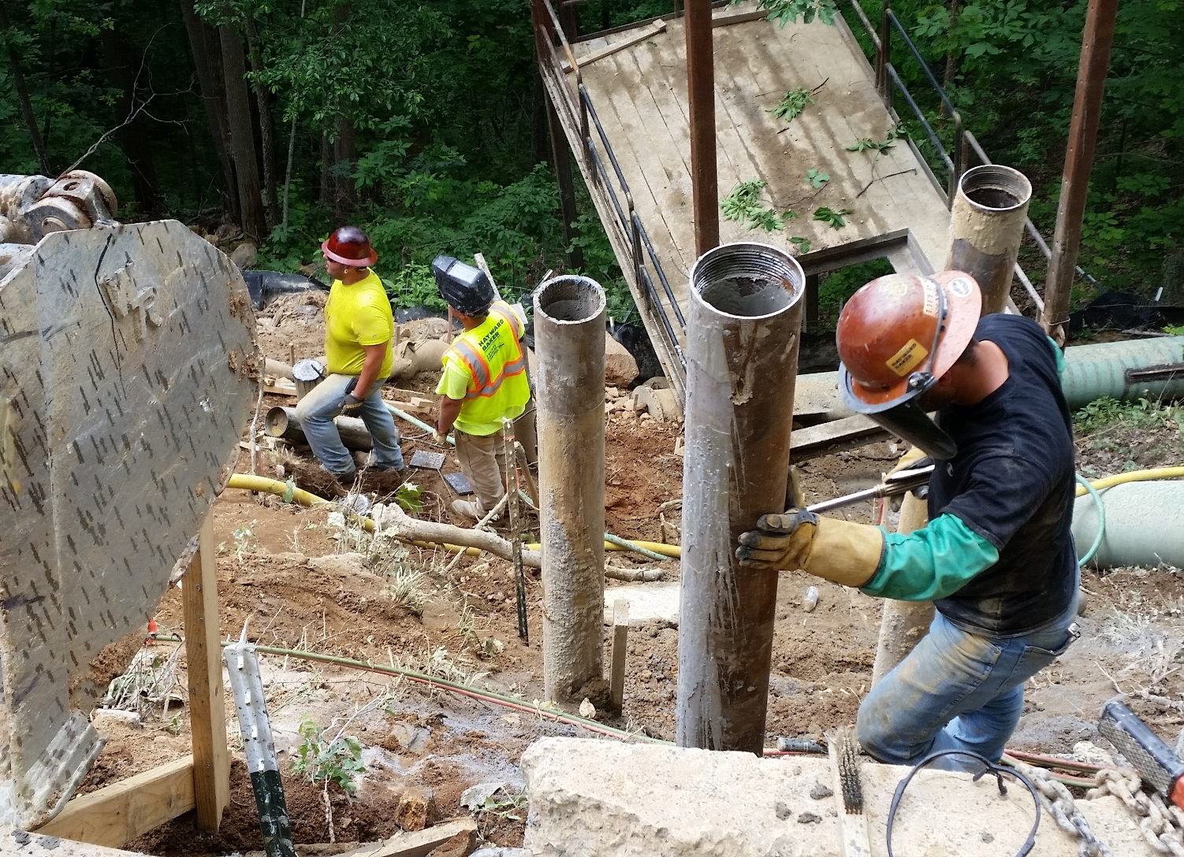

Slide 51
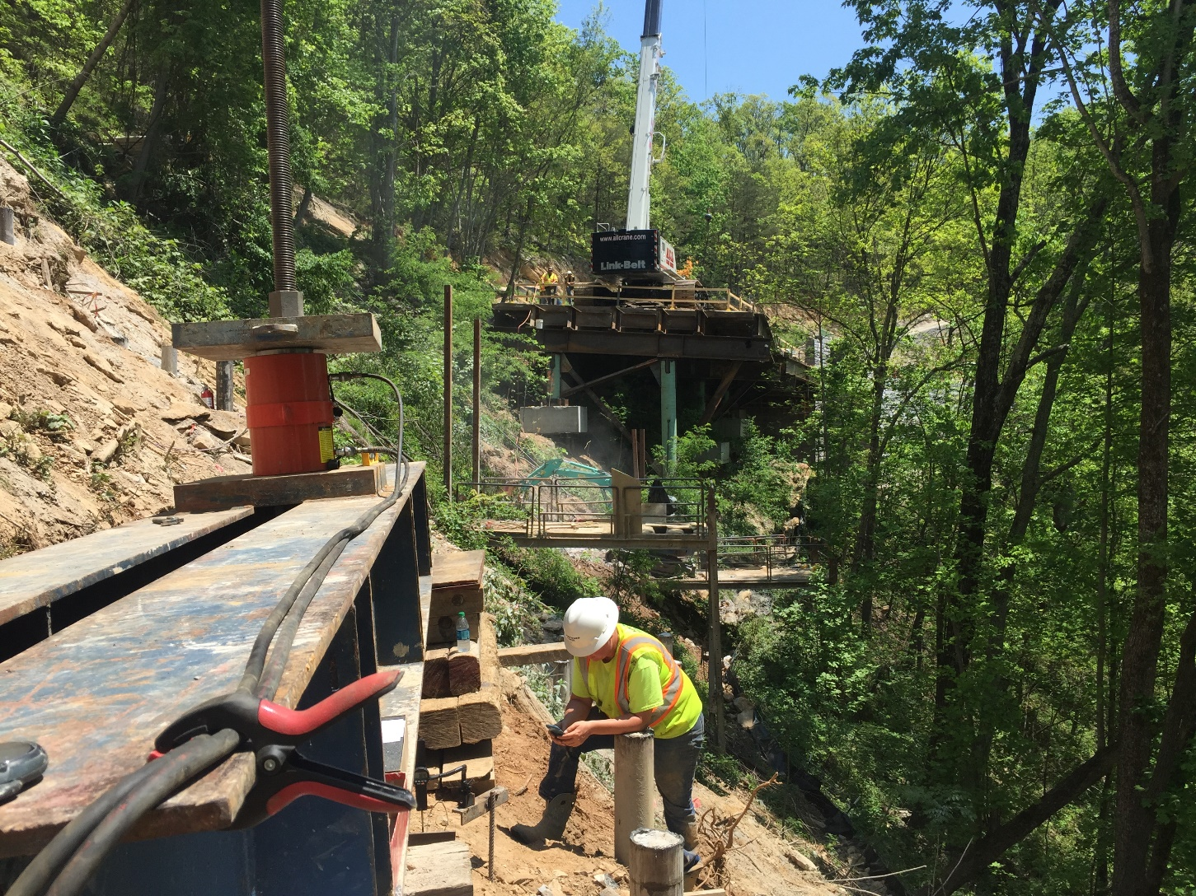

Slide 52
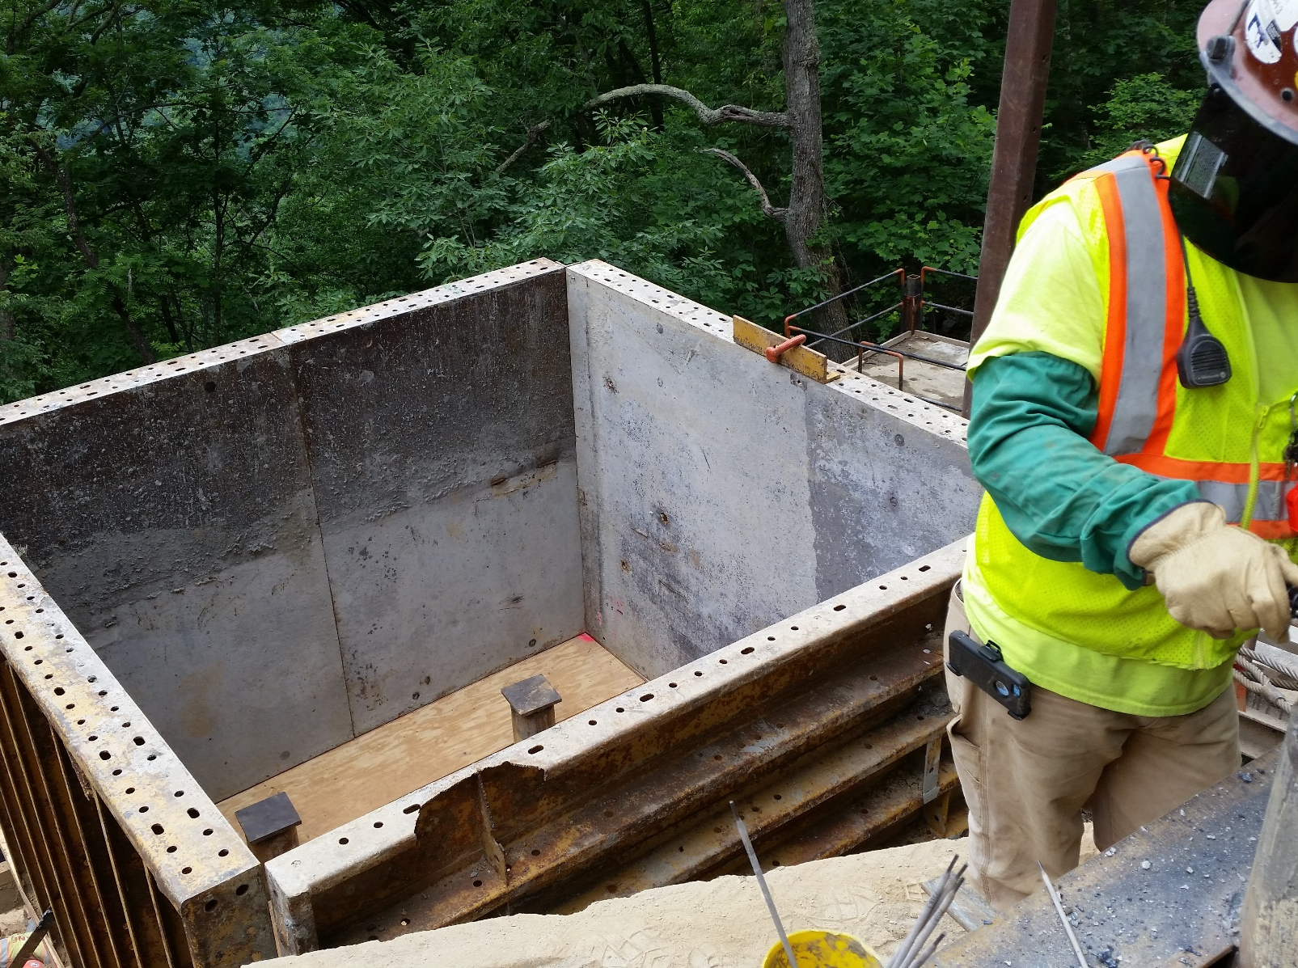

Slide 53
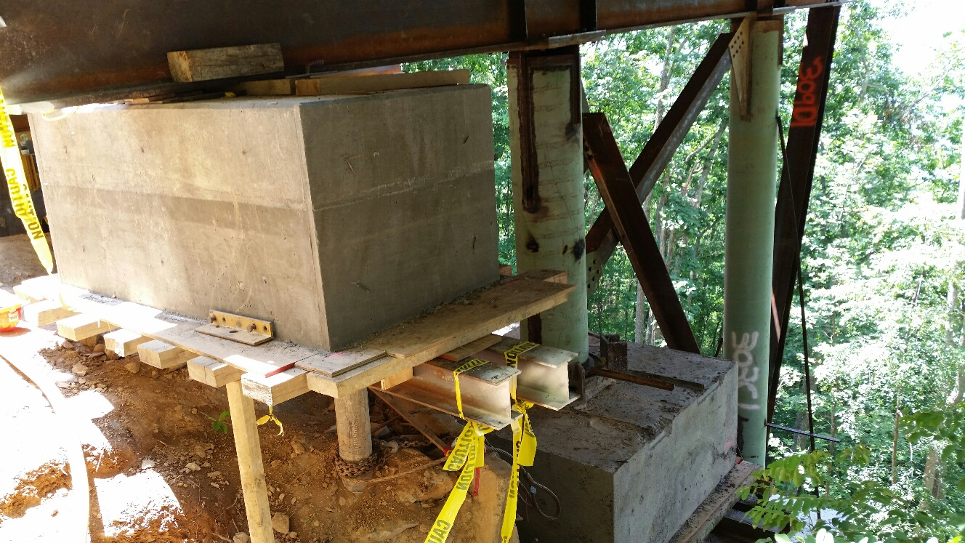
Falsework MP Cap with Columns

Slide 54
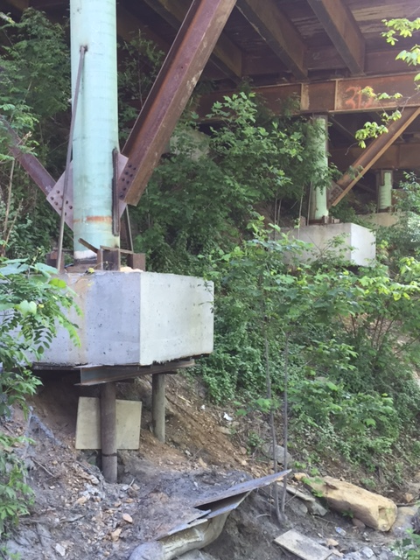

Slide 55
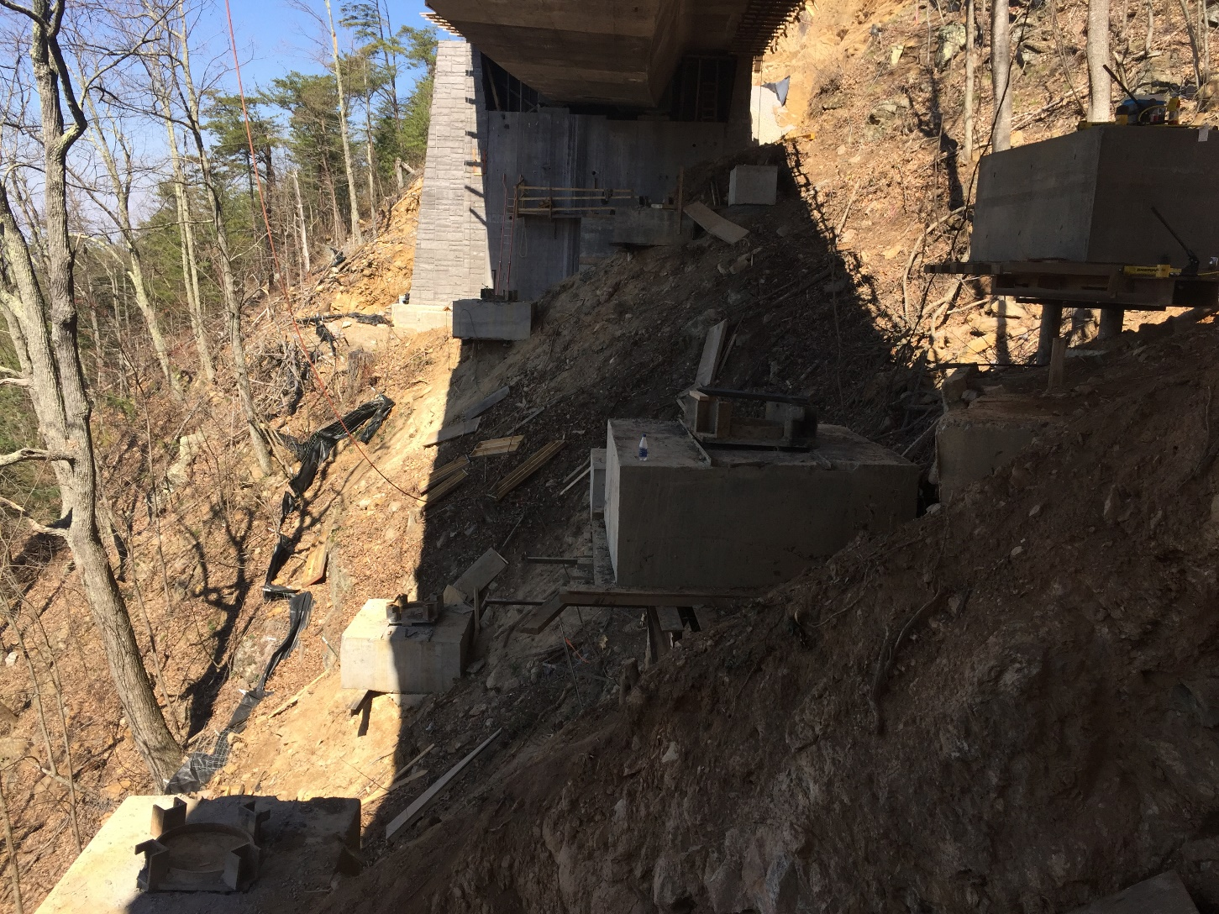

Slide 56

Questions?
Tony Sak, PE
asak@haywardbaker.com

